Slide 1
MACHINE LEANINING SUMMER SCHOOL 2012 KYOTO
Briefing & Report
By: Masayuki Kouno (D1) & Kourosh Meshgi (D1)
Kyoto University, Graduate School of Informatics, Department of Systems Science
Ishii Lab (Integrated System Biology)

Slide 2
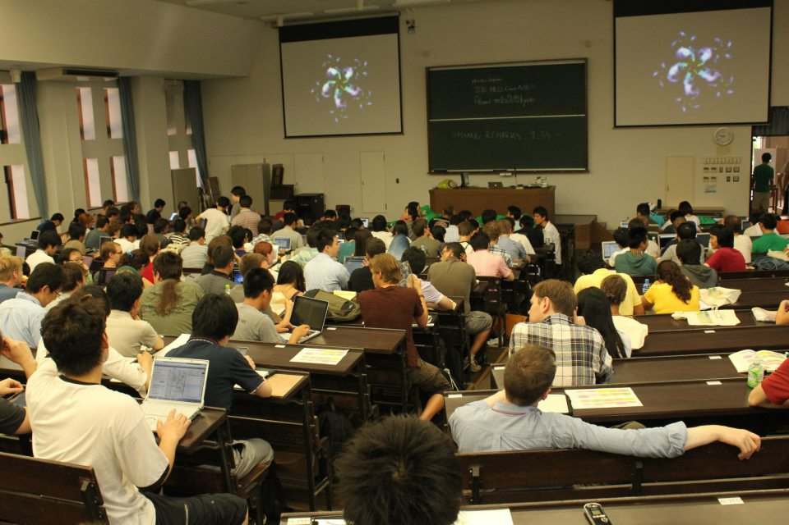
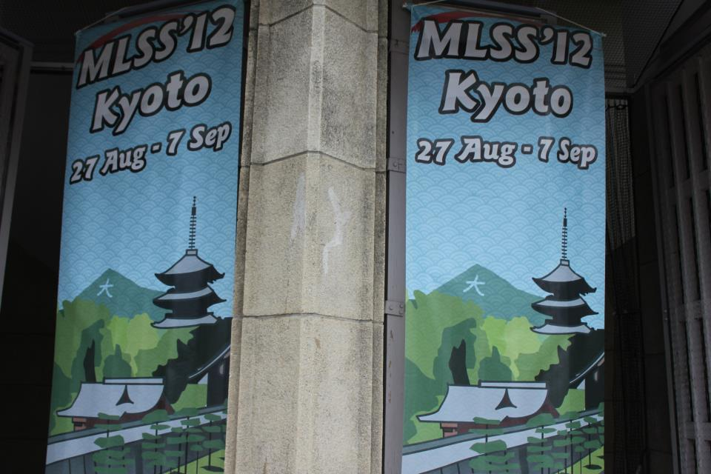
Contents
School Information
Demographics
Schedule
Topics
Social Events

Slide 3
School Information
From Machine Learning Summer School Series (http://www.mlss.cc/)
From August 27th (Mon) to September 7th (Fri)
“Probably the NERDIEST place on earth at that time”!
Website: http://www.i.kyoto-u.ac.jp/mlss12/
Location: Yoshida Campus
Lecture Hall: Faculty of Law and Economics
Poster Sessions: Clock Tower
Organized by
Prof. Akihiro Yamamoto, Department of Intelligence Science and Technology (http://www.iip.ist.i.kyoto-u.ac.jp/member/akihiro/index-e.html)
Associate Prof. Masashi Sugiyama, Tokyo Institute of Technology (http://sugiyama-www.cs.titech.ac.jp/~sugi/)
Associate Prof. Marco Cuturi (Manager), Department of Intelligence Science and Technology (http://www.iip.ist.i.kyoto-u.ac.jp/member/cuturi/index.html)

Slide 4
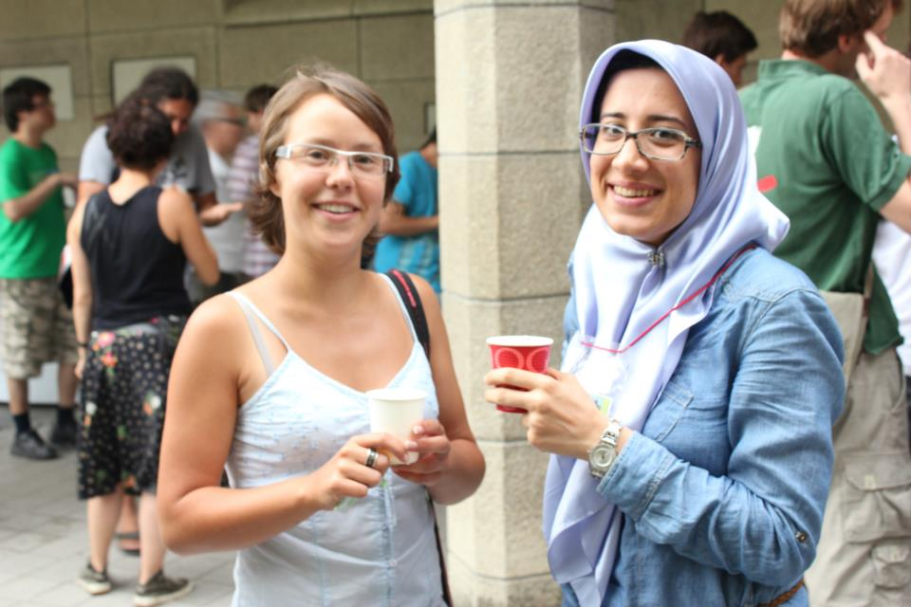
Demographics
1st In Japan, 300 Attendants, 52 Different Countries
One-third Japanese, 7 Iranians, lots of Russians, Germans, French, etc. from different institutions…

Slide 5
Schedule
 | Mon. 27th | Tue. 28th | Wed. 29th | Thu. 30th | Fri. 31st
8:30 - 10:10 | Opening | Domingos | Vandenberghe | Vandenberghe | Lin
10:30 - 12:10 | Rakhlin | Rakhlin | Vandenberghe | Müller | Lin
Lunch Break
13:50 - 15:30 | Rakhlin | Tsuda | Tsuda | Müller | Schapire
15:50 - 17:30 | Domingos | Tsuda | Müller | Schapire | Schapire
17:50 - 19:30 | Domingos | Poster I | Doya | Poster II | Okada
 | Mon. 3rd | Tue. 4th | Wed. 5th | Thu. 6th | Fri. 7th
8:30 - 10:10 | Wainwright | Blei | Blei | Vempala | Fukumizu
10:30 - 12:10 | Wainwright | Blei | Vempala | Fukumizu | Fukumizu
Lunch Break
13:50 - 15:30 | Doucet | Doucet | Vempala | Bach | Bach
15:50 - 17:30 | Doucet | Wainwright | Takemura | Bach | Sugiyama
17:50 - 19:30 | Poster III | Amari | Banquet | Iwata

Slide 6
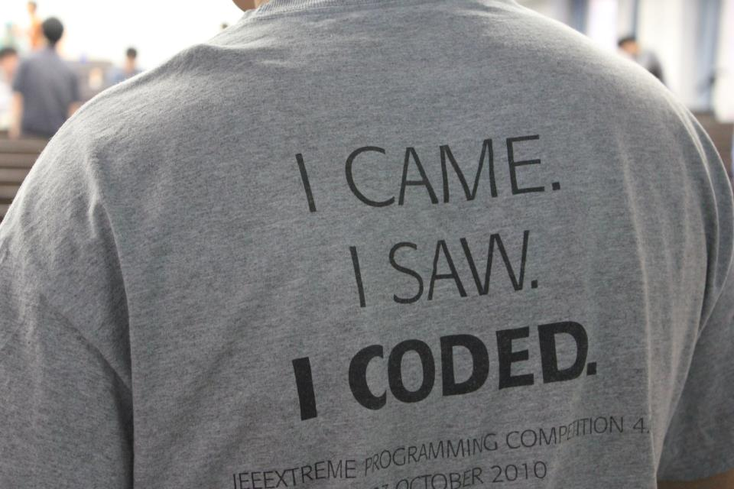
Topics
Statistical Learning Theory
Submodularity
Graphical Models
Probabilistic Topic Models
Statistical Relational Learning
Sampling (Monte Carlo, High Dimensional, …)
Boosting
Kernel Methods
Graph Mining
Convex Optimization
Short Talks: Information Geometry, Reinforcement Learning, Density Ratio Estimation, Holonomic Gradient Methods

Slide 7
Statistical Learning Theory
Sasha RAKHLIN, University of Pennsylvania/Wharton
Slides: http://stat.wharton.upenn.edu/~rakhlin/ml_summer_school.pdf
Good Speaker, General & Useful Topic
The goal of Statistical Learning is to explain the performance of existing learning methods and to provide guidelines for the development of new algorithms. This tutorial will give an overview of this theory. We will discuss mathematical definitions of learning, the complexities involved in achieving good performance, and connections to other fields, such as statistics, probability, and optimization. Topics will include basic probabilistic inequalities for the risk, the notions of Vapnik-Chervonenkis dimension and the uniform laws of large numbers, Rademacher averages and covering numbers. We will briefly discuss sequential prediction methods.

Slide 8
Statistical Learning Theory
The Setteing of SLT
Consistency, No Free Lunch Theorems, Bias-Variance Tradeoff
Tools from Probability, Empirical Processes
From Finite to Infinite Classes
Uniform Convergence, Symmetrization, and Rademacher Complexity
Large Margin Theory for Classification
Properties of Rademacher Complexity
Covering Numbers and Scale-Sensitive Dimensions
Faster Rates
Model Selection
Sequential Prediction / Online Learning
Motivation
Supervised Learning
Online Convex and Linear Optimization
Online-to-Batch Conversion, SVM optimization

Slide 9
Statistical Relational Learning
Pedro DOMINGOS, University of Washington
Slides: https://www.dropbox.com/s/qxedx9oj37gyjgf/srl-mlss.pdf
Fast Monotone Speaker, Specialized Topic
Most machine learning algorithms assume that data points are i.i.d. (independent and identically distributed), but in reality objects have varying distributions and interact with each other in complex ways. Domains where this is prominently the case include the Web, social networks, information extraction, perception, medical diagnosis/epidemiology, molecular and systems biology, ubiquitous computing, and others. Statistical relational learning (SRL) addresses these problems by modeling relations among objects and allowing multiple types of objects in the same model. This tutorial will cover foundations, key ideas, state-of-the-art algorithms and applications of SRL.

Slide 10
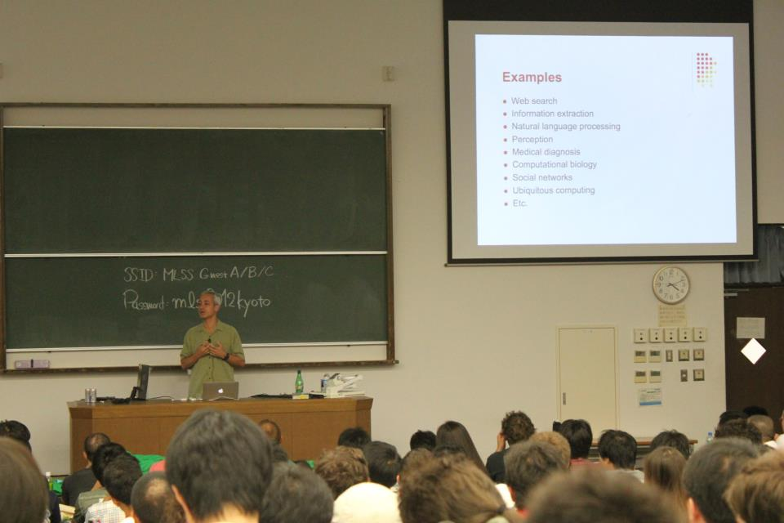
Motivation
Foundational areas
Probabilistic inference → Markov Networks
Statistical learning → Learning Markov Networks
Learning parameters → Weights
Learning Structure → Features
Logical inference → First Order Logic
Inductive logic programming → Rule Induction
Putting the pieces together
Key Dimensions → Logical Lang. , Prob. Lang., Type of Learning, Type of Inference
Survey of Previous Models
Markov Logic
Applications

Slide 11
Graph Mining
Koji TSUDA, AIST Computational Biology Research Center
Slides:
https://dl.dropbox.com/u/11277113/mlss_tsuda_mining_chapter1.pdf
https://dl.dropbox.com/u/11277113/mlss_tsuda_learning_chapter2.pdf
https://dl.dropbox.com/u/11277113/mlss_tsuda_kernel_chapter3.pdf
English Speech with Japanese Accent, Specialized Topic
Labeled graphs are general and powerful data structures that can be used to represent diverse kinds of objects such as XML code, chemical compounds, proteins, and RNAs. In these 10 years, we saw significant progress in statistical learning algorithms for graph data, such as supervised classification, clustering and dimensionality reduction. Graph kernels and graph mining have been the main driving force of such innovations. In this lecture, I start from basics of the two techniques and cover several important algorithms in learning from graphs. Successful biological applications are featured. If time allows, I will also cover recent developments and show future directions

Slide 12
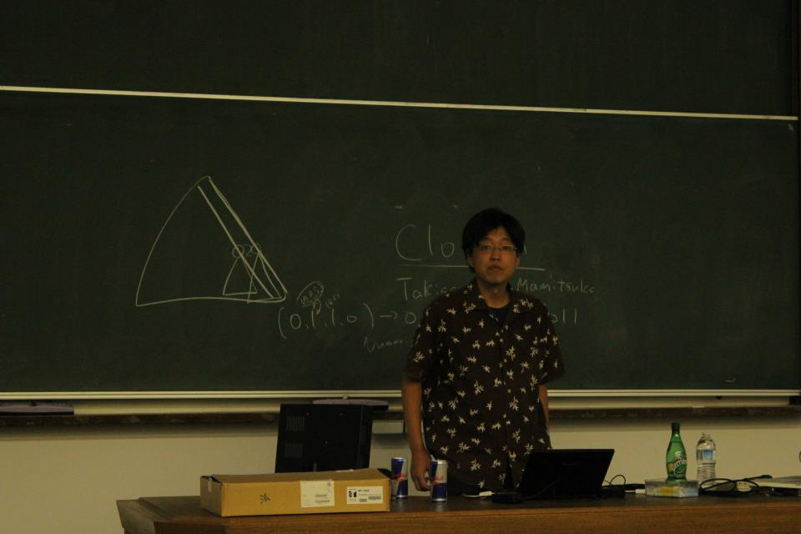
Data Mining
Structured Data in Biology → DNA, RNA, Aminoacid Sequence → Hidden Structures
Frequent Itemset Mining
Closed Itemset Mining
Ordered Tree Mining
Unordered Tree Mining
Graph Mining
Dense Module Enumeration
Learning from Structured data
Preliminaries → Graph Mining → gSpan
Graph Clustering by EM
Graph Boosting → Motivation: Lack of Descriptors, New Feature(Pattern) Discovery
Regularization Paths in Graph Classification
Itemset Boosting for predicting HIV drug resistance
Kernel
Kernel Method Revisited → Kernel Trick, Valid Kernels, Design
Marginalized Kernels (Fisher Kernels)
Marginalized Graph Kernels
Weisfeiler-Lehman kernels → Graph to Bag-of-Words
Reaction Graph kernels

Slide 13
Convex Optimization
Lieven VANDENBERGHE, UCLA
Slides: http://www.ee.ucla.edu/~vandenbe/shortcourses/mlss12-convexopt.pdf
Monotone Speaker, Perfect Survey of All Approaches, Not Good for Learning from Scratch
The tutorial will provide an introduction to the theory and applications of convex optimization, and an overview of recent algorithmic developments. Part one will cover the basics of convex analysis, focusing on the results that are most useful for convex modeling, i.e., recognizing and formulating convex optimization problems in practice. We will introduce conic optimization and the two most widely studied types of non-polyhedral conic optimization problems, second-order cone and semidefinite programs. Part two will cover interior-point methods for conic optimization. The last part will focus on first-order algorithms for large-scale convex optimization.

Slide 14
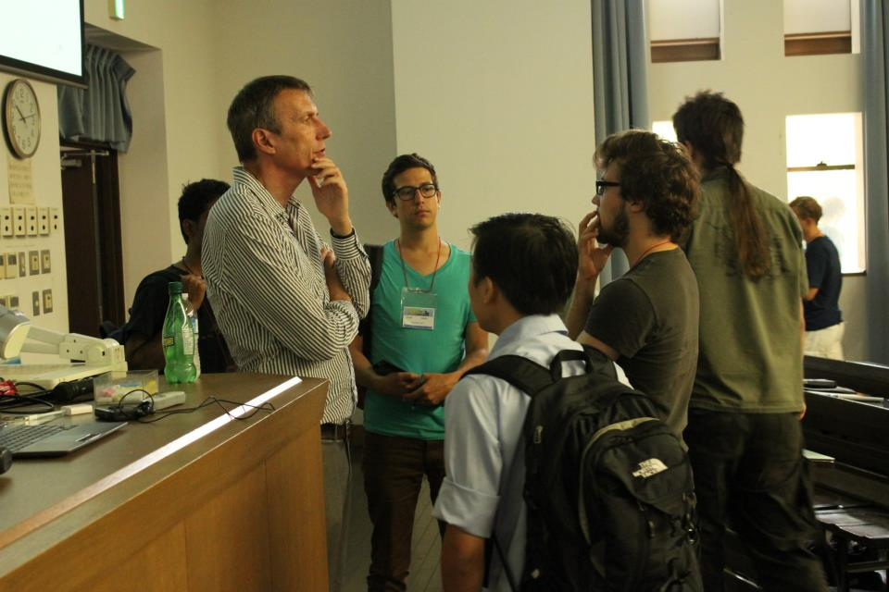
Basic theory and convex modeling
Convex sets and functions
Common problem classes and applications
Interior-point methods for conic optimization
Conic optimization
Barrier methods
Symmetric primal-dual methods
First-order methods
(Proximal) Gradient algorithms
Dual techniques and multiplier methods

Slide 15
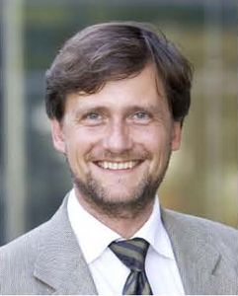
Brain-Computer Interfacing
Klaus-Robert MÜLLER, TU Berlin & Korea Univ
Slides: http://stat.wharton.upenn.edu/~rakhlin/ml_summer_school.pdf
Good Speaker, Nice Topic, Abstract Presentation
Brain Computer Interfacing (BCI) aims at making use of brain signals for e.g. the control of objects, spelling, gaming and so on. This tutorial will first provide a brief overview of the current BCI research activities and provide details in recent developments on both invasive and non-invasive BCI systems. In a second part – taking a physiologist point of view – the necessary neurological/neurophysical background is provided and medical applications are discussed. The third part – now from a machine learning and signal processing perspective – shows the wealth, the complexity and the difficulties of the data available, a truely enormous challenge. In real-time a multi-variate very noise contaminated data stream is to be processed and classified. Main emphasis of this part of the tutorial is placed on feature extraction/selection, dealing with nonstationarity and preprocessing which includes among other techniques CSP. Finally, I report in more detail about the Berlin Brain Computer (BBCI) Interface that is based on EEG signals and take the audience all the way from the measured signal, the preprocessing and filtering, the classification to the respective application. BCI communication is discussed in a clinical setting and for gaming.

Slide 16
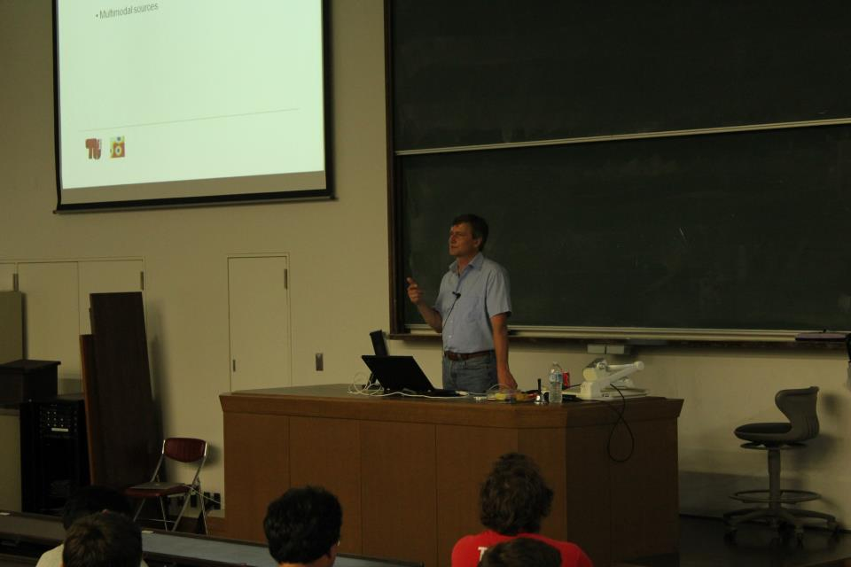
Part I
Physiology, Signals and Challenges → ECoG, Berlin BCI
Single-trial vs. Averaging
Session to Session Variability
Inter Subject Variability
Event-Related Desynchronization and BCI
Part II
Nonstationarity SSA
Shifting distributions within experiment
Mathematical flavors of non-stationarity → Bias adaptation between training and test, Covariate shift, SSA: projecting to stationary subspaces, Nonstationarity due to subject dependence: Mixed effects model, Co-adaptation
Multimodal data
Part III
Event Related Potentials and BCI
CCA: Correlating Apples and Oranges → Kernel CCA → Time kCCA
Applications

Slide 17
Neural Implementation of RL
Kenji DOYA, Okinawa Institute of Technology
Slides: https://www.dropbox.com/s/xpxwdqasj1hpi4r/Doya2012mlss.pdf
Good Speaker, Specialized Topic
The theory of reinforcement learning provides a computational framework for understanding the brain's mechanisms for behavioral learning and decision making. In this lecture, I will present our studies on the representation of action values in the basal ganglia, the realization of model-based action planning in the network linking the frontal cortex, the basal ganglia, and the cerebellum, and the regulation of the temporal horizon of reward prediction by the serotonergic system.

Slide 18
Reinforcement Learning Survey
TD Errors: Dopamine Neurons
Basal Ganglia for RL
Action Value Coding in Striatum
POMDP by Cortex-Basal Ganglia
Neuromodulators for Metalearning
Dopamine: TD error δ
Acetylcholine: learning rate α
Noradrenaline: exploration β
Serotonin: temporal discount γ

Slide 19
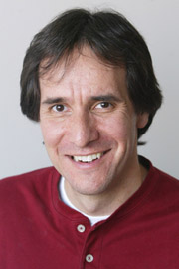
Boosting
Robert SCHAPIRE, Princeton University
Slides: http://www.cs.princeton.edu/~schapire/talks/mlss12.pdf
Perfect Speaker, Good Topic
Boosting is a general method for producing a very accurate classification rule by combining rough and moderately inaccurate “rules of thumb.” While rooted in a theoretical framework of machine learning, boosting has been found to perform quite well empirically. This tutorial will focus on the boosting algorithm AdaBoost, and will explain the underlying theory of boosting, including explanations that have been given as to why boosting often does not suffer from overfitting, as well as interpretations based on game theory, optimization, statistics, and maximum entropy. Some practical applications and extensions of boosting will also be described.

Slide 20
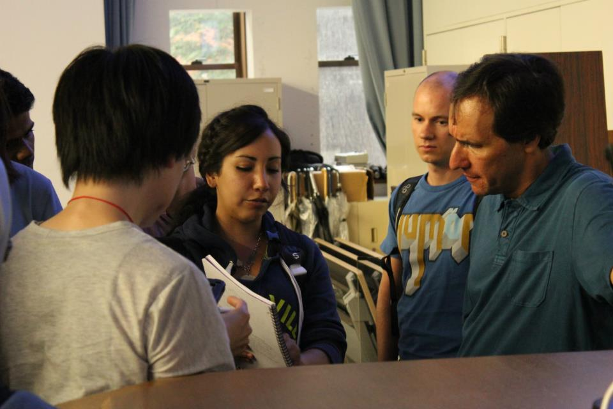
Basic Algorithm and Core Theory
Introduction to AdaBoost
Analysis of training error
Analysis of test error and the margins theory
Experiments and applications
Fundamental Perspectives
Game theory
Loss minimization
Information-geometric view
Practical Extensions
Multiclass classification
Ranking problems
Confidence-rated predictions
Advanced Topics
Optimal accuracy
Optimal efficiency
Boosting in continuous time

Slide 21
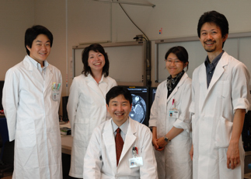
Clinical Applications of Medical Image Analyses
Tomohisa OKADA, Graduate School of Medicine, KU
Slides: https://www.dropbox.com/s/3pifb7uqi330wpd/MachineLearningSummerSchool2012_Okada.pdf
Bad Speaker, Specific Topic, Not Informative
Advances in medical imaging modalities have given us enormous databases of medical images. There is much information to learn from them, but extracting information with bare eyes only is by no means an easy task. However, with wide-spread application of functional MRI, analysis methods of brain images that borrow from machine learning have also dramatically improved. I would like to present some examples of their clinical applications, to draw the interest of the audience and possibility encourage further work in the field of medical image processing.

Slide 22
Disease with Unknown Reasons → Reasons Embedded in Images → Aging, Alzheimer, Atrophy, Seizers
MRI Imaging
Rest State
Tractography
Fourier Transform
ICA

Slide 23
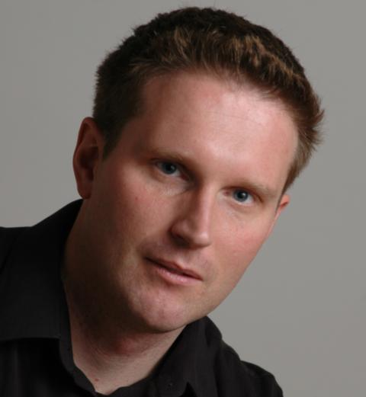
Graphical Models and Message-passing
Martin WAINWRIGHT, University of California, Berkeley
Slides: http://www.eecs.berkeley.edu/~wainwrig/kyoto12/
Perfect Speaker, General Topic, Very Informative
Graphical models allow for flexible modeling of large collections of random variables, and play an important role in various areas of statistics and machine learning. In this series of introductory lectures, we introduce the basics of graphical models, as well as associated message-passing algorithms for computing marginals, modes, and likelihoods in graphical models. We also discuss methods for learning graphical models from data.

Slide 24
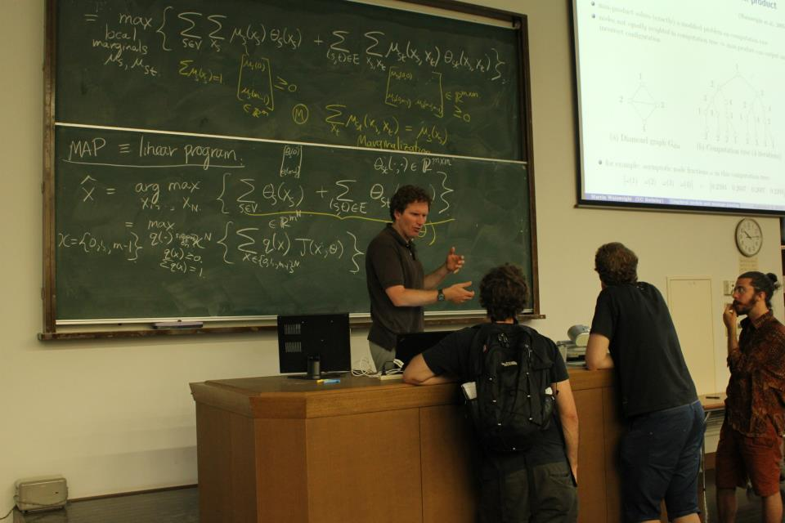
Compute most probable (MAP) assignment
Max-product message-passing on trees
Max-product on graph with cycles
A more general class of algorithms
Reweighted max-product and linear programming
Compute marginals and likelihoods
Sum-product message-passing on trees
Sum-product on graph with cycles
Learning the parameters and structure of graphs from data
Learning for pairwise models
Graph selection
Factorization and Markov properties
Information theory: Graph selection as channel coding

Slide 25
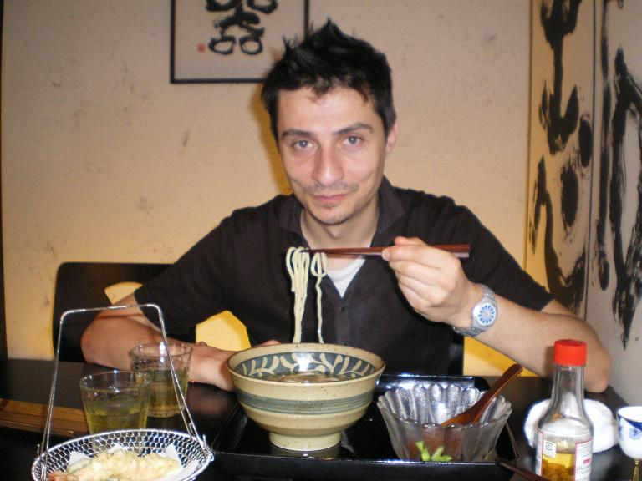
Sequential Monte Carlo Methods for Bayesian Computation
Arnaud DOUCET, University of Oxford
Slides: https://www.dropbox.com/s/d34mg9499gytr2t/kyoto_1.pdf
Rapper-Like Fast Speaker with French Accent, Good Topic, Noone Understand Nothing! (Including us!)
Sequential Monte Carlo are a powerful class of numerical methods used to sample from any arbitrary sequence of probability distributions. We will discuss how Sequential Monte Carlo methods can be used to perform successfully Bayesian inference in non-linear non-Gaussian state-space models, Bayesian non-parametric time series, graphical models, phylogenetic trees etc. Additionally we will present various recent techniques combining Markov chain Monte Carlo methods with Sequential Monte Carlo methods which allow us to address complex inference models that were previously out of reach.

Slide 26
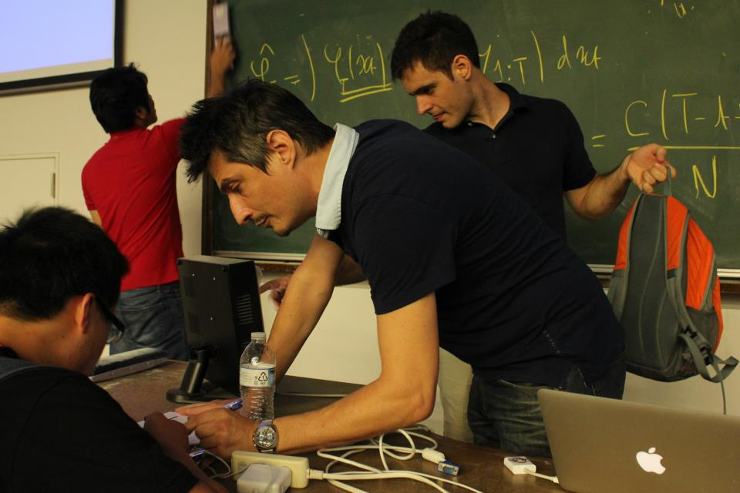
State-Space Models
SMC filtering and smoothing
Maximum likelihood parameter inference
Bayesian parameter inference
Beyond State-Space SMC methods for generic sequence of target distributions
SMC samplers.
Approximate Bayesian Computation.
Optimal design, optimal control.

Slide 27
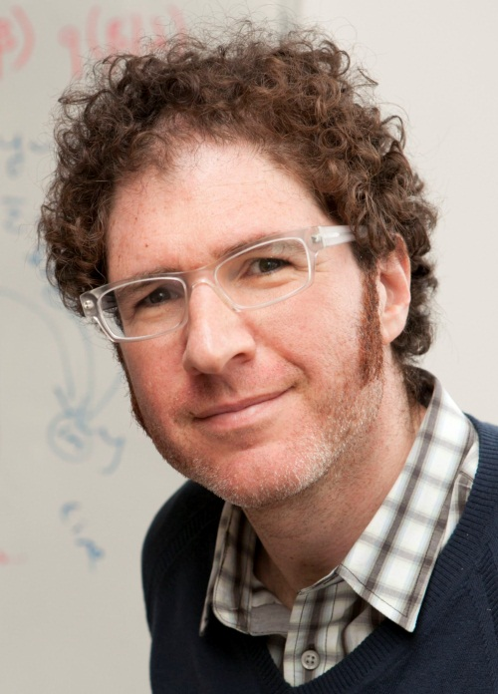
Probabilistic Topic Models
David BLEI, Princeton University
Slides: http://www.cs.princeton.edu/~blei/blei-mlss-2012.pdf
Perfect Speaker, ½ General + ½ Specialized Talk
Probabilistic topic modeling provides a suite of tools for the unsupervised analysis of large collections of documents. Topic modeling algorithms can uncover the underlying themes of a collection and decompose its documents according to those themes. This analysis can be used for corpus exploration, document search, and a variety of prediction problems.
Topic modeling assumptions: I will describe latent Dirichlet allocation (LDA), which is one of the simplest topic models, and then describe a variety of ways that we can build on it. These include dynamic topic models, correlated topic models, supervised topic models, author-topic models, bursty topic models, Bayesian nonparametric topic models, and others. I will also discuss some of the fundamental statistical ideas that are used in building topic models, such as distributions on the simplex, hierarchical Bayesian modeling, and models of mixed-membership.
Algorithms for computing with topic models: I will review how we compute with topic models. I will describe approximate posterior inference for directed graphical models using both sampling and variational inference, and I will discuss the practical issues and pitfalls in developing these algorithms for topic models. Finally, I will describe some of our most recent work on building algorithms that can scale to millions of documents and documents arriving in a stream.
Applications of topic models: I will discuss applications of topic models. These include applications to images, music, social networks, and other data in which we hope to uncover hidden patterns. I will describe some of our recent work on adapting topic modeling algorithms to collaborative filtering, legislative modeling, and bibliometrics without citations.

Slide 28
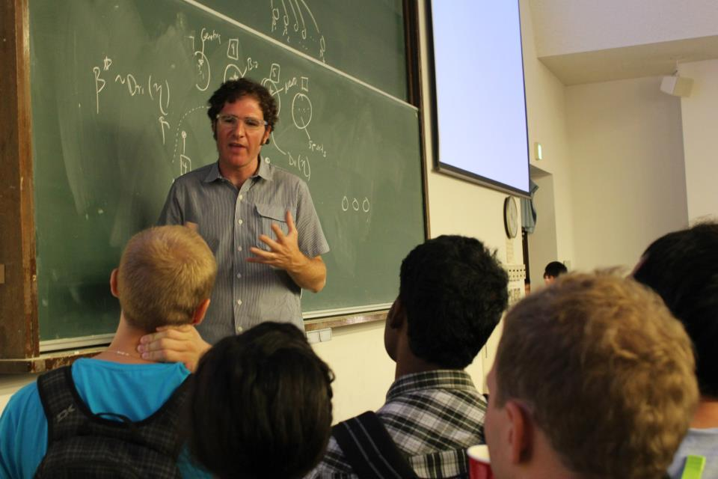
Introduction to Topic Modeling
Latent Dirichlet Allocation (LDA)
Beyond Latent Dirichlet Allocation
Correlated and Dynamic Topic Models
Supervised Topic Models
Modeling User Data and Text
Bayesian Nonparametric Models

Slide 29
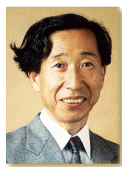
Information Geometry in ML
Shun-Ichi AMARI, RIKEN Brain Science Institute
Slides: http://www.brain.riken.jp/labs/mns/amari/home-E.html
Good Speaker, Extra Hard Topic
Information geometry studies invariant geometrical structures of a family of probability distributions, which forms a geometrical manifold. It has a unique Riemannian metric given by Fisher information matrix and a dual pair of affine connections which determine two types of geodesics. When the manifold is dually flat, there exists a canonical divergence (KL-divergence) and nice theorems such as generalized Pythagorean theorem, projection theorem and orthogonal foliation theorem hold in spite that the manifold is not Euclidean. Machine learning makes use of stochastic structures of the environmental information so that information geometry is not only useful for understanding the essential aspects of machine learning but also provides nice tools for constructing new algorithms. The present talk demonstrates its usefulness for understanding SVM, belief propagation, EM algorithm, boosting and others.

Slide 30
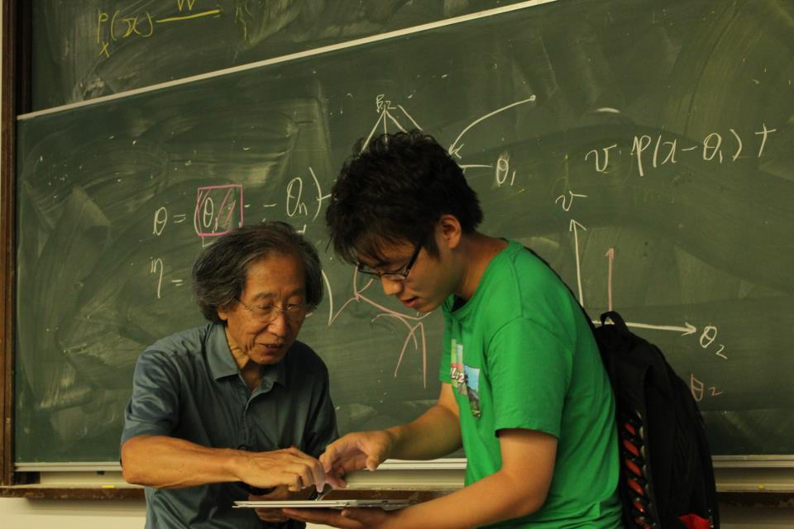
Information Geometry
Invariance
Affine Connections & Their Dual
Divergence
Belief Propagation
Mean Field Approximation
Gradient
Sparse Signal Analysis

Slide 31
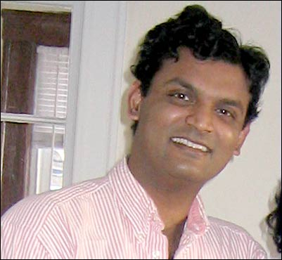
High-dimensional Sampling Alg.
Santosh VEMPALA, Georgia Tech
Slides:
https://dl.dropbox.com/u/12319193/High-Dimensional%20Sampling%20Algorithms.pdf
https://dl.dropbox.com/u/12319193/HDA2.pdf
https://dl.dropbox.com/u/12319193/HDA3.pdf
Good Speaker, Good Topic, Not Motivational Talk
We study the complexity, in high dimension, of basic algorithmic problems such as optimization, integration, rounding and sampling. A suitable convexity assumption allows polynomial-time algorithms for these problems, while still including very interesting special cases such as linear programming, volume computation and many instances of discrete optimization. We will survey the breakthroughs that lead to the current state-of-the-art and pay special attention to the discovery that all of the above problems can be reduced to the problem of *sampling* efficiently. In the process of establishing upper and lower bounds on the complexity of sampling in high dimension, we will encounter geometric random walks, isoperimetric inequalities, generalizations of convexity, probabilistic proof techniques and other methods bridging geometry, probability and complexity.

Slide 32
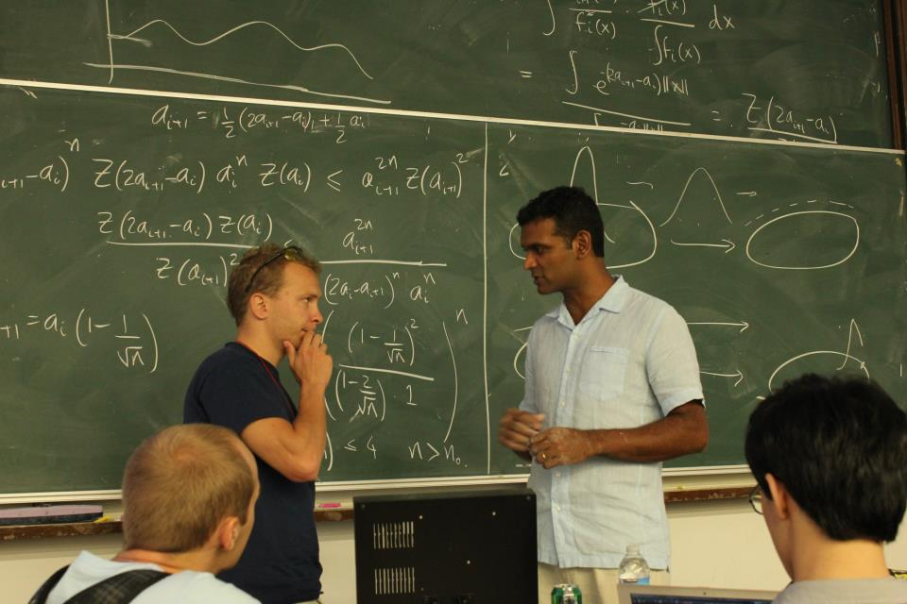
Introduction
Computational problems in high dimension
The challenges of high dimensionality
Convex bodies, Logconcave functions
Brunn-Minkowski and its variants
Isotropy
Summary of applications
Algorithmic Applications
Convex Optimization
Rounding
Volume Computation
Integration
Sampling Algorithms
Sampling by random walks
Conductance
Grid walk, Ball walk, Hit-and-run
Isoperimetric inequalities
Rapid mixing

Slide 33
Introduction to the Holonomic Gradient Method in Statistics
Akimichi TAKEMURA, University of Tokyo
Slides: http://park.itc.u-tokyo.ac.jp/atstat/takemura-talks/120905-takemura-slide.pdf
Bad Speaker, Good Topic
The holonomic gradient method introduced by Nakayama et al. (2011) presents a new methodology for evaluating normalizing constants of probability distributions and for obtaining the maximum likelihood estimate of a statistical model. The method utilizes partial differential equations satisfied by the normalizing constant and is based on the Grobner basis theory for the ring of differential operators. In this talk we give an introduction to this new methodology. The method has already proved to be useful for problems in directional statistics and in classical multivariate distribution theory involving hypergeometric functions of matrix arguments.

Slide 34
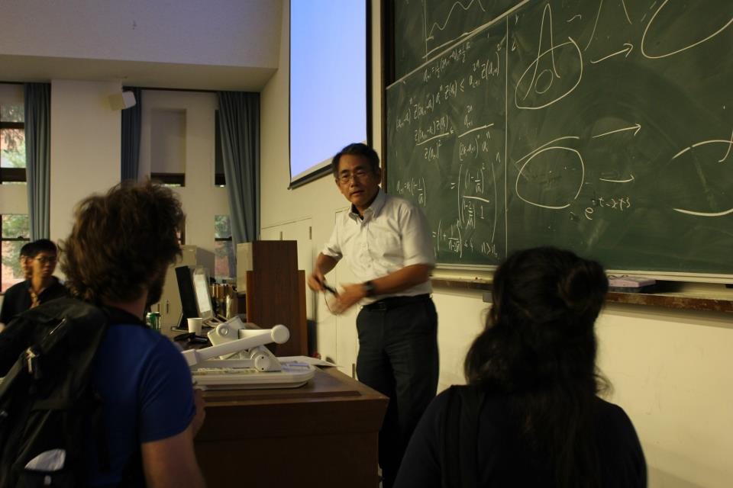
First example: Airy-like function
Holonomic function and holonomic gradient method (HGM)
Another example: incomplete gamma function
Wishart distribution and hypergeometric function of a matrix argument
HGM for two-dimensional Wishart matrix
Pfaffian system for general dimension
Numerical experiments

Slide 35
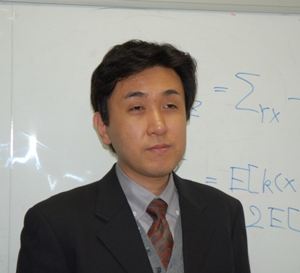
Kernel Methods for Statistical Learning
Kenji FUKUMIZU, Institute of Statistical Mathematics
Slides: http://www.ism.ac.jp/~fukumizu/MLSS2012/
Good Speaker (Good accent too), Good Topic
Following the increasing popularity of support vector machines, kernel methods have been successfully applied to various machine learning problems and have established themselves as a computationally efficient approach to extract non-linearity or higher order moments from data. The lecture is planned to include the following topics:
Basic idea of kernel methods: feature mapping and kernel trick for efficient extraction of nonlinear information.
Algorithms: support vector machines, kernel principal component analysis, kernel canonical correlation analysis, etc.
Mathematical foundations: mathematical theory on positive definite kernels and reproducing kernel Hilbert spaces.
Nonparametric inference with kernels: brief introduction to the recent developments on nonparametric (model-free) statistical inference using kernel mean embedding.

Slide 36
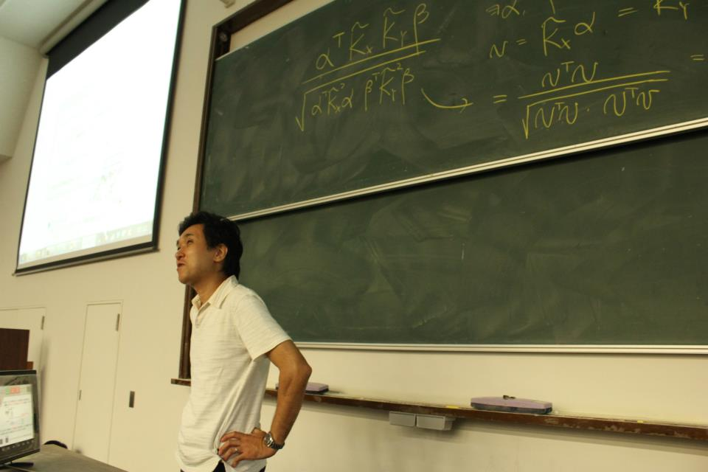
Introduction to kernel methods
Various kernel methods
kernel PCA
kernel CCA
kernel ridge regression
Support vector machine
A brief introduction to SVM
Theoretical backgrounds of kernel methods
Mathematical aspects of positive definite kernels
Nonparametric inference with positive definite kernels
Recent advances of kernel methods

Slide 37
Learning with Submodular Functions
Francis BACH, Ecole Normale Superieure/INRIA
Slides: http://www.di.ens.fr/~fbach/submodular_fbach_mlss2012.pdf
Good Speaker but Strong French Accent, General Topic
Submodular functions are relevant to machine learning for mainly two reasons: (1) some problems may be expressed directly as the and (2) the Lovasz extension of submodular functions provides a useful set of regularization functions for supervised and unsupervised learning.
In this course, I will present the theory of submodular functions from a convex analysis perspective, presenting tight links between certain polyhedra, combinatorial optimization and convex optimization problems. In particular, I will show how submodular function minimization is equivalent to solving a wide variety of convex optimization problems. This allows the derivation of new efficient algorithms for approximate submodular function minimization with theoretical guarantees and good practical performance. By listing examples of submodular functions, I will also review various applications to machine learning, such as clustering or subset selection, as well as a family of structured sparsity-inducing norms that can be derived and used from submodular functions.

Slide 38
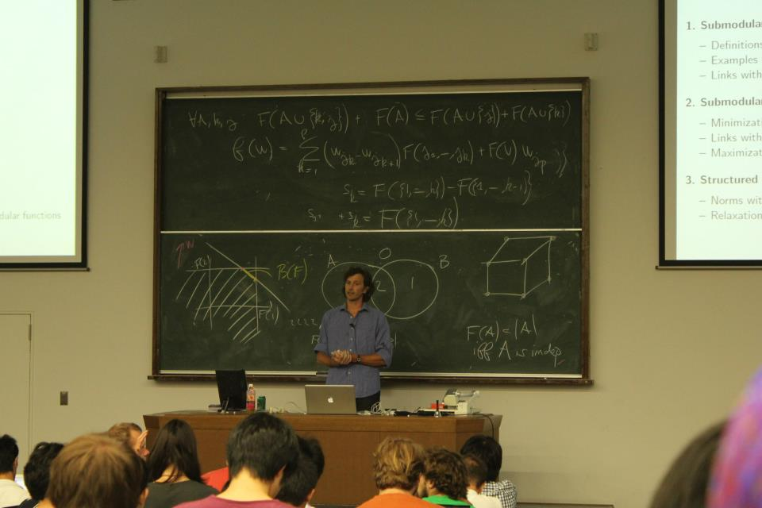
Submodular functions
Definitions
Examples of submodular functions
Links with convexity through Lovasz extension
Submodular optimization
Minimization
Links with convex optimization
Maximization
Structured sparsity-inducing norms
Norms with overlapping groups
Relaxation of the penalization of supports by submodular functions

Slide 39
Submodular Optimization and Approximation Algorithms
Satoru IWATA, Kyoto University
Slides: https://dl.dropbox.com/u/12319193/MLSS_Iwata.pdf
Fair Speaker, Specialized Topic
Submodular functions are discrete analogues of convex functions. Examples include cut capacity functions, matroid rank functions, and entropy functions. Submodular functions can be minimized in polynomial time, which provides a fairly general framework of efficiently solvable combinatorial optimization problems. In contrast, the maximization problems are NP-hard and several approximation algorithms have been developed so far.
In this lecture, I will review the above results in submodular optimization and present recent approximation algorithms for combinatorial optimization problems described in terms of submodular functions.

Slide 40
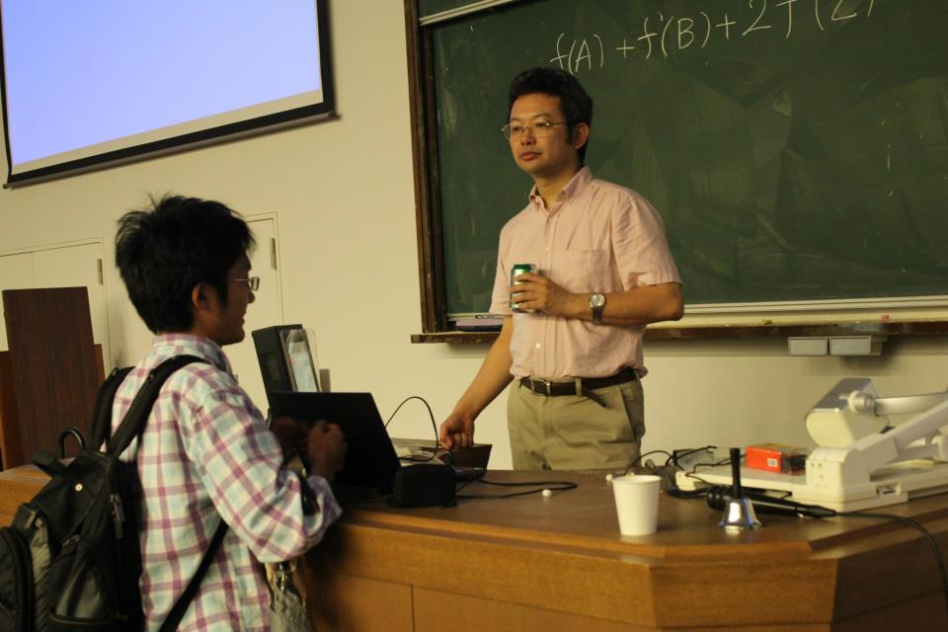
Submodular Functions
Examples
Discrete Convexity
Submodular Function Minimization
Approximation Algorithms
Submodular Function Maximization
Approximating Submodular Functions

Slide 41
Machine Learning Software: Design and Practical Use
Chih-Jen LIN, National Taiwan University & eBay Research Labs
Slides: http://www.csie.ntu.edu.tw/~cjlin/talks/mlss_kyoto.pdf
Good Speaker, Interesting Topic
The development of machine learning software involves many issues beyond theory and algorithms. We need to consider numerical computation, code readability, system usability, user-interface design, maintenance, long-term support, and many others. In this talk, we take two popular machine learning packages, LIBSVM and LIBLINEAR, as examples. We have been actively developing them in the past decade. In the first part of this talk, we demonstrate the practical use of these two packages by running some real experiments. We give examples to see how users make mistakes or inappropriately apply machine learning techniques. This part of the course also serves as a useful practical guide to support vector machines (SVM) and related methods. In the second part, we discuss design considerations in developing machine learning packages. We argue that many issues other than prediction accuracy are also very important.

Slide 42
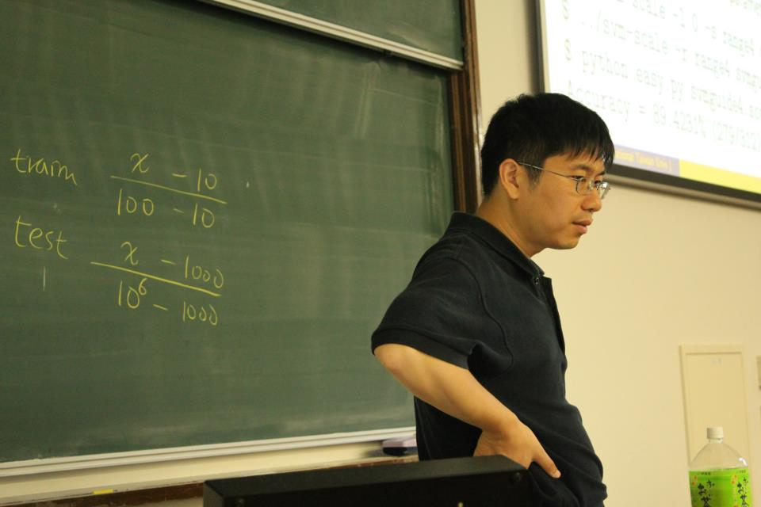
Practical use of SVM
SVM introduction
A real example
Parameter selection
Design of machine learning software
Users and their needs
Design considerations
Discussion and conclusions

Slide 43
Density Ratio Estimation in ML
Masashi SUGIYAMA, Tokyo Institute of Technology
Slides: http://sugiyama-www.cs.titech.ac.jp/~sugi/2012/MLSS2012.pdf
Good Speaker, Useful Topic
In statistical machine learning, avoiding density estimation is essential because it is often more difficult than solving a target machine learning problem itself. This is often referred to as Vapnik's principle, and the support vector machine is one of the successful realizations of this principle. Following this spirit, a new machine learning framework based on the ratio of probability density functions has been introduced. This density-ratio framework includes various important machine learning tasks such as transfer learning, outlier detection, feature selection, clustering, and conditional density estimation. All these tasks can be effectively and efficiently solved in a unified manner by estimating directly the density ratio without actually going through density estimation. In this lecture, I give an overview of theory, algorithms, and application of density ratio estimation.

Slide 44
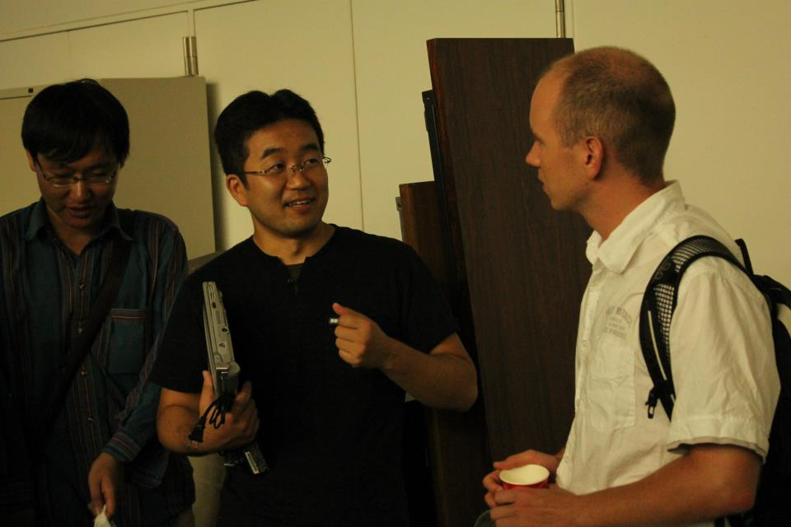
Introduction
Methods of Density Ratio Estimation
Probabilistic Classification
Moment Matching
Density Fitting
Density-Ratio Fitting
Usage of Density Ratios
Importance sampling
Distribution comparison
Mutual information estimation
Conditional probability estimation
More on Density Ratio Estimation
Unified Framework
Dimensionality Reduction
Relative Density Ratios

Slide 45
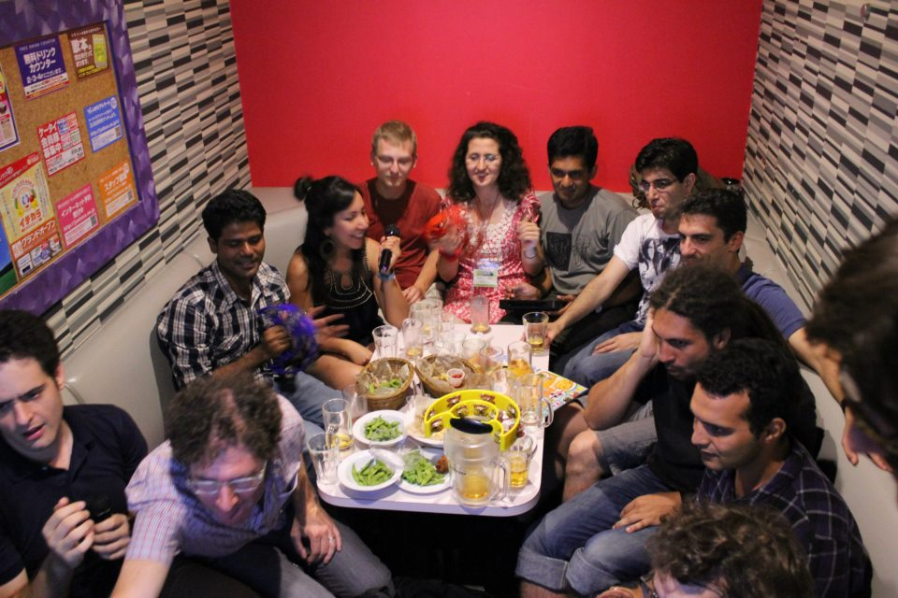
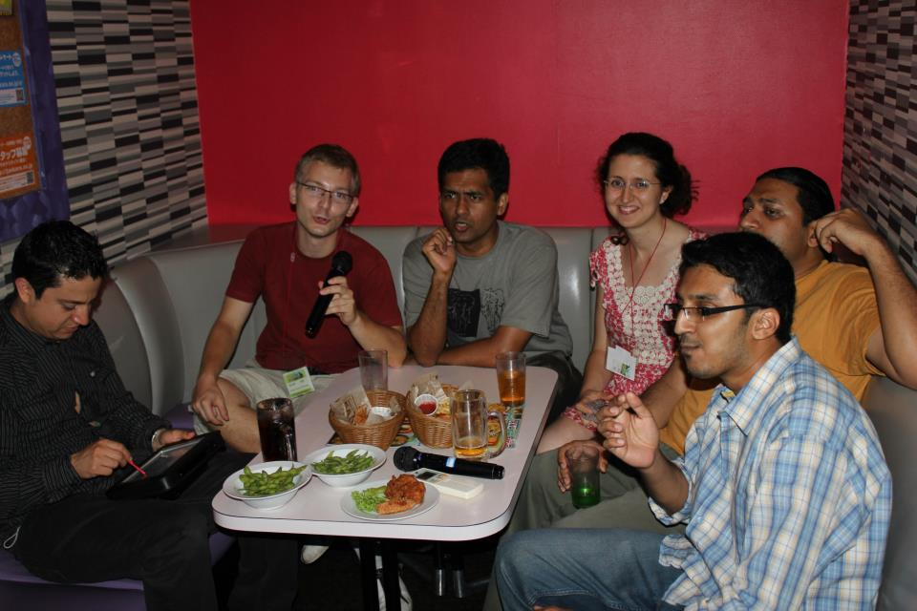
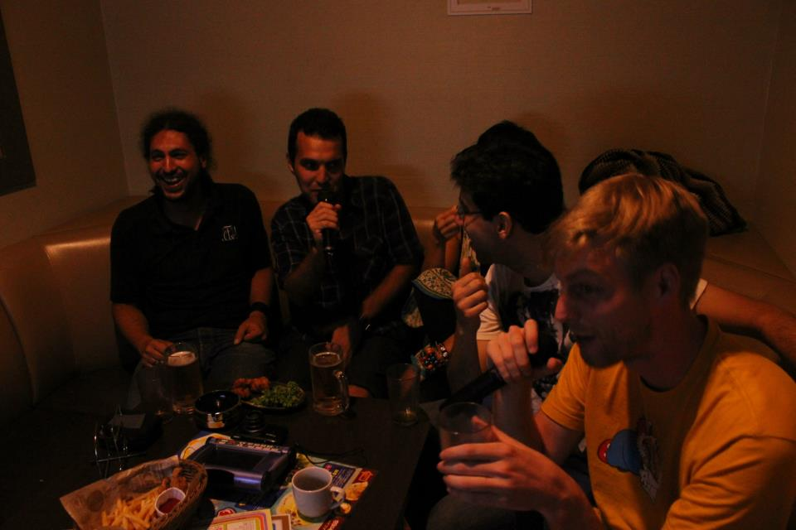
Massive Karaoke Party
Kawaramachi, Super Jumbo Jankara
2nd and 3rd Floor Completely
Light snacks provided
Supposed to end by 22:30 but extended to 24:00

Slide 46
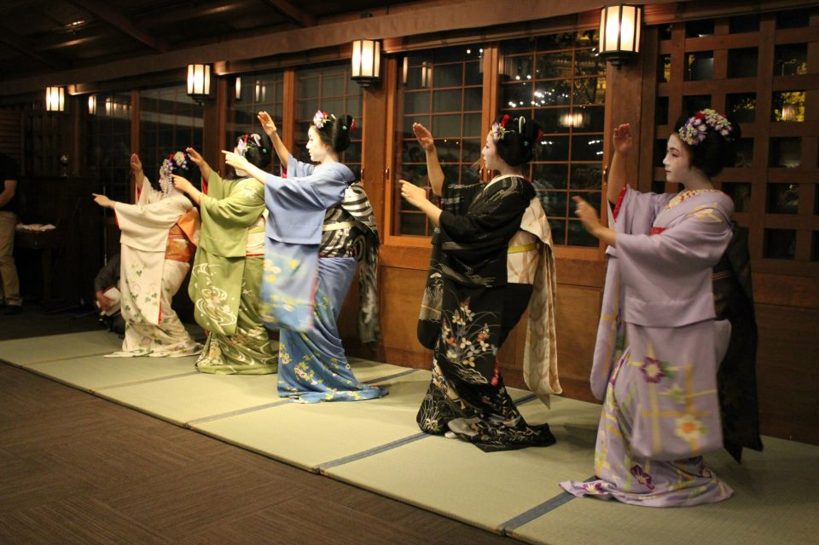
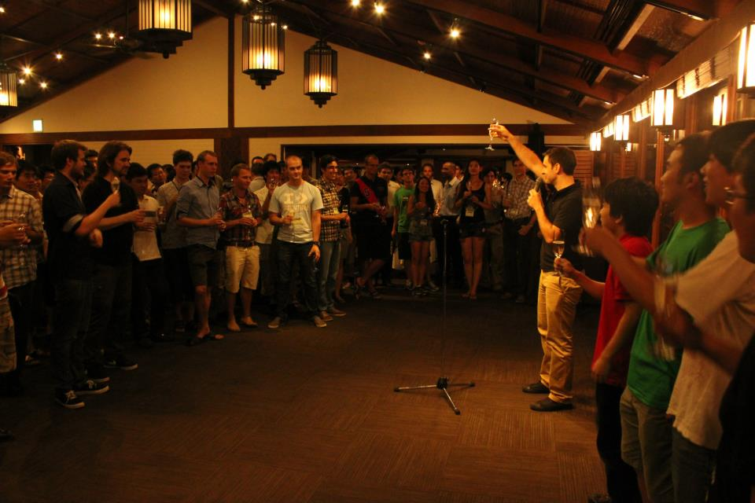
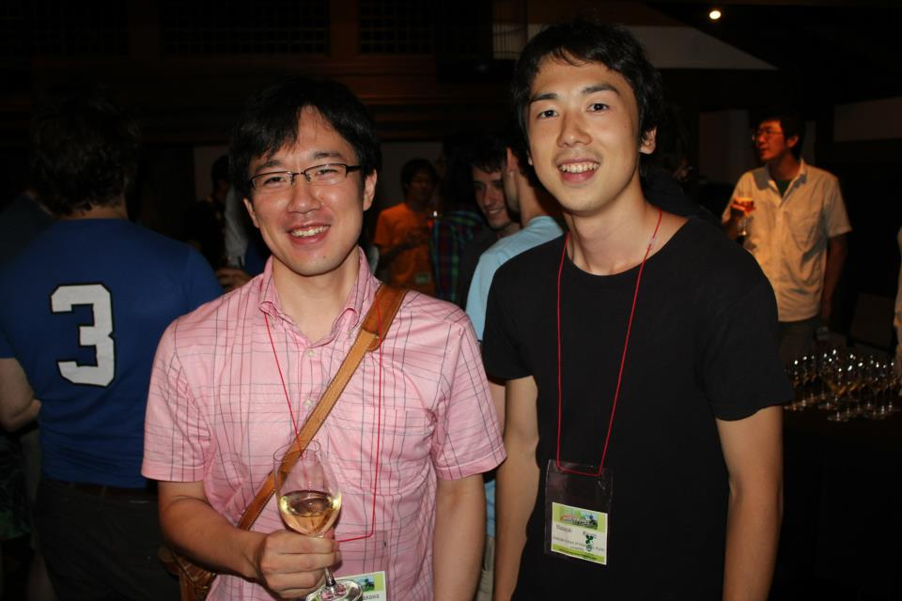
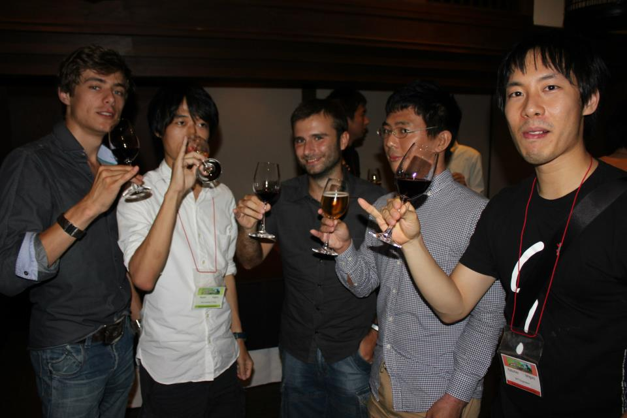
Banquet Dinner in Gion
Garden Oriental Kyoto
Went By Bus
Program
Socializing and Dinner and of Drinking
Banquet Talk
Geisha (Maiko) Performance
Japanese Music Performance

Slide 47
Group Photo

Slide 48
Group Photo

Slide 49
Group Photo

Slide 50
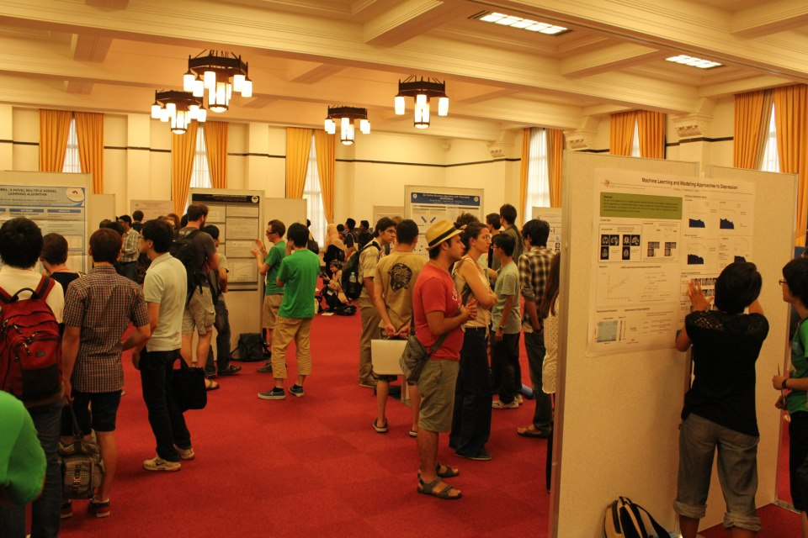
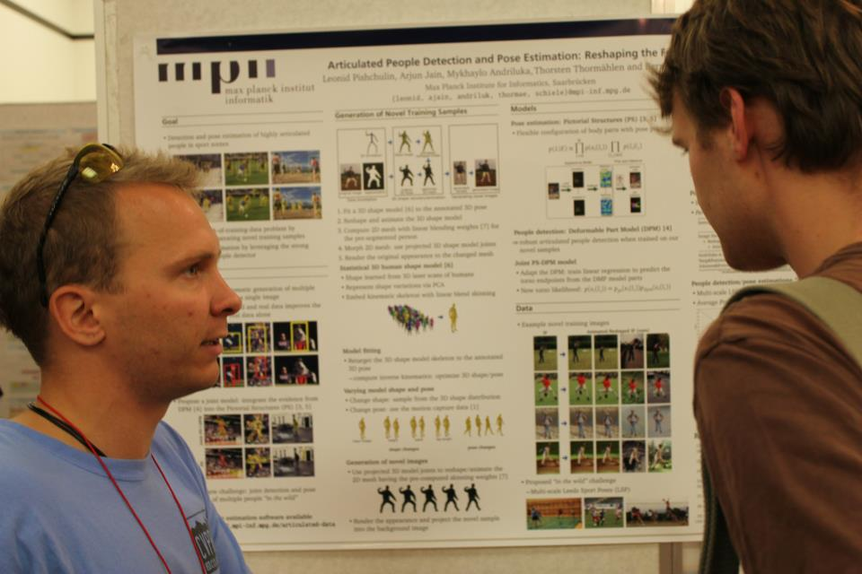
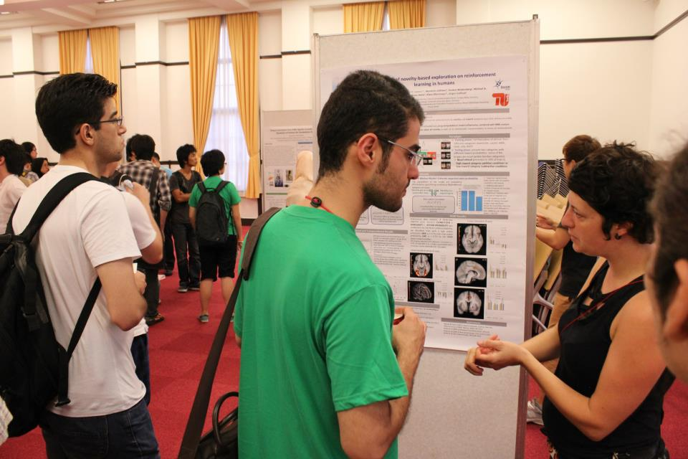
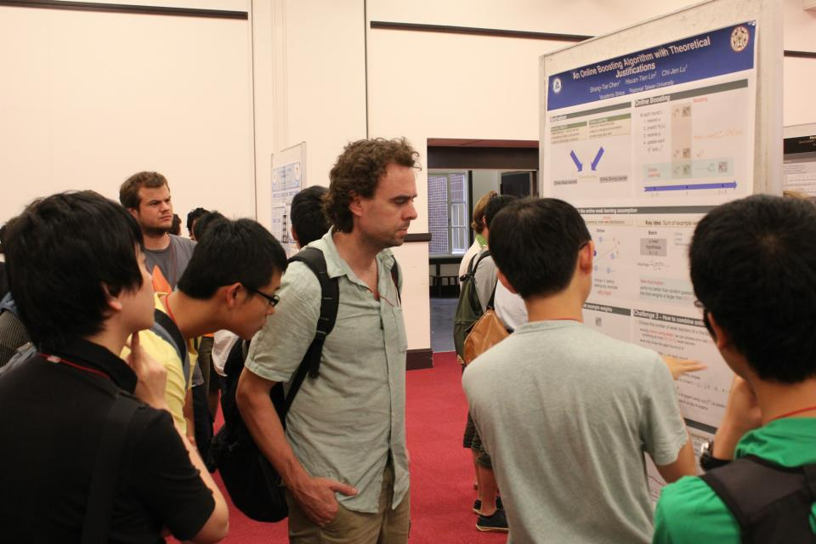
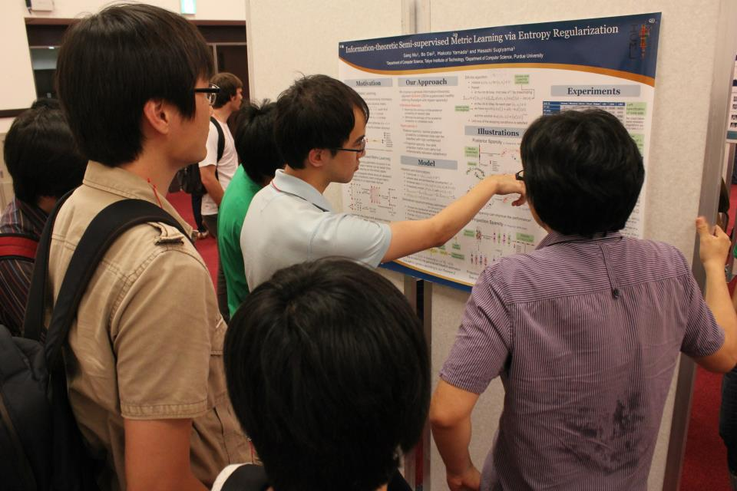
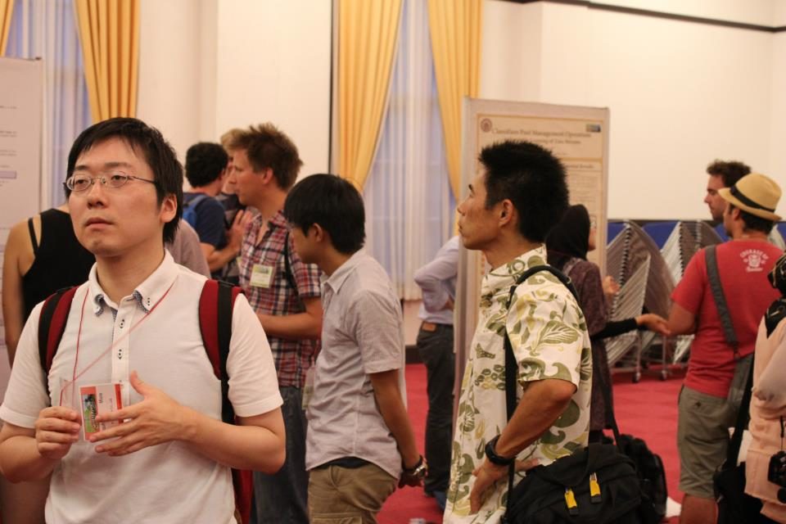
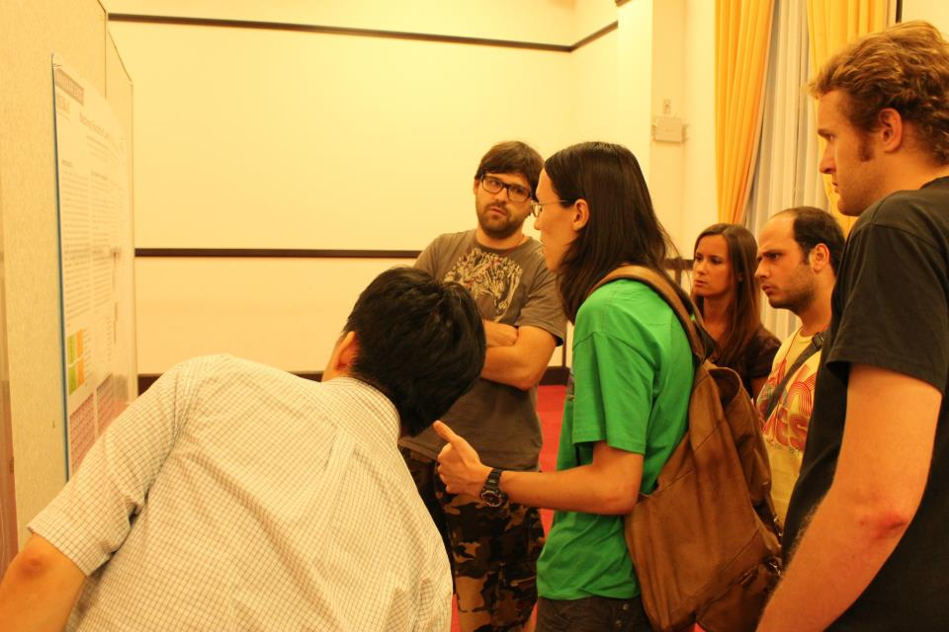
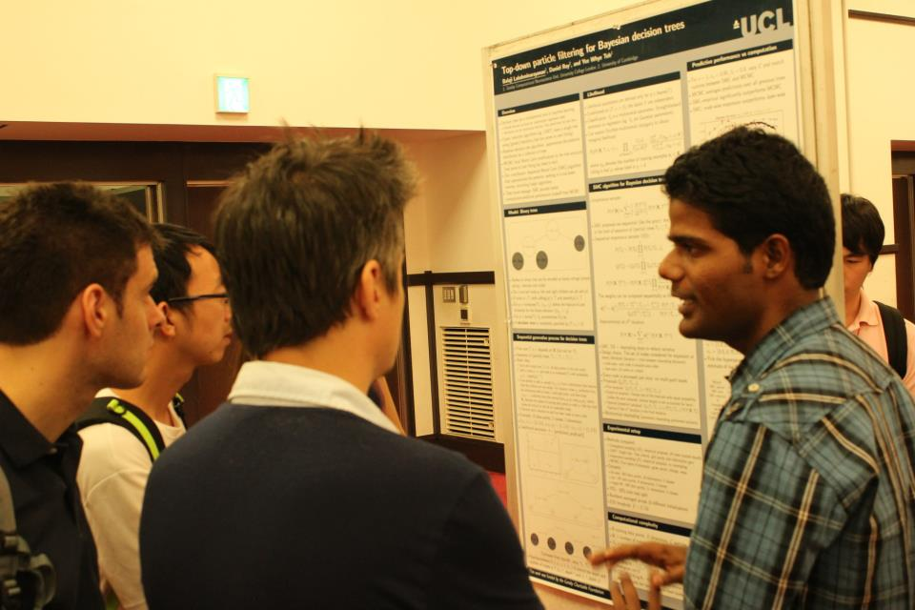
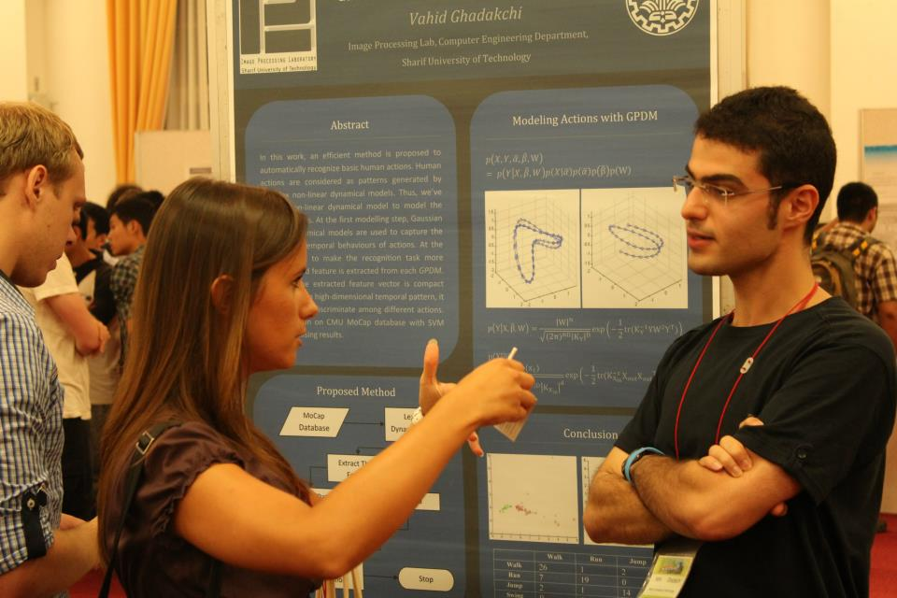
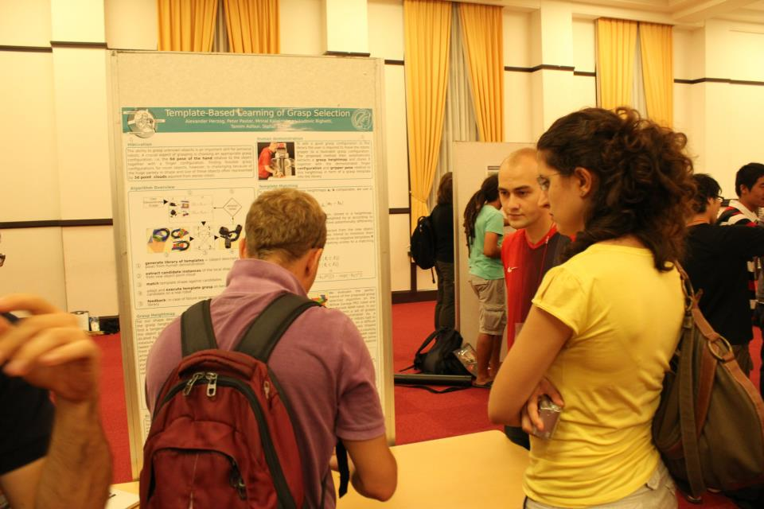
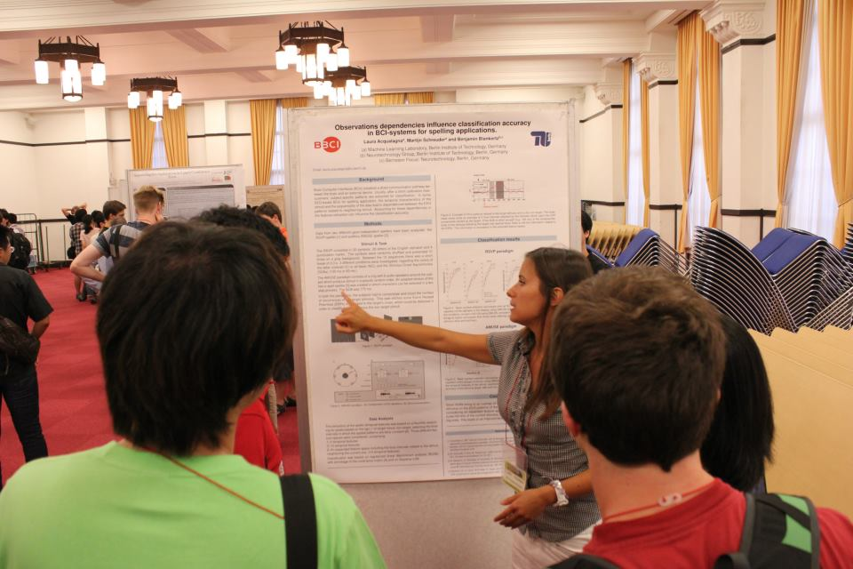
Poster Sessions

Slide 51
